Slide 1
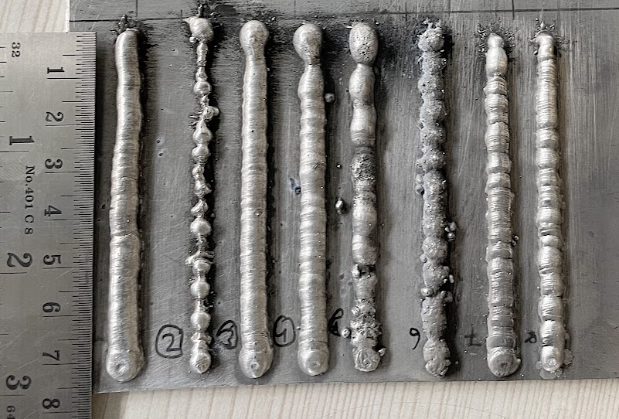
Experiment No
1 | 2 | 3 | 4 | 5 | 6 | 7 | 8

Slide 2
Ex. No | Wire feed Rate (m/min) | Travel speed (mm/sec) | Gas flow rate (L/min)
1 | 8 | 4 | 20
2 | 4 | 4 | 20
3 | 8 | 4 | 15
4 | 8 | 4 | 10
5 | 8 | 4 | 5
6 | 8 | 4 | 0
7 | 8 | 5 | 15
8 | 8 | 6 | 15
Constant parameters
Voltage -OCV (V) | 50
Contact tube distance (mm) | 15
Torch Angle (degree) | 90

